Slide 1
APOLOGETICS
IN ONE LESSON
almost
Ai1L.net
Introduction

Slide 2
Which would the large majority of non-believing New Testament scholars agree to?
The disciples were transformed & were willing to die for their message
Jesus was crucified
Jesus’ disciples had real experiences of the resurrected Jesus
James (Jesus’ brother) had a real experience that he thought was an appearance of Jesus
Paul also had a similar appearance of Jesus and converted
1
The Gospel was proclaimed within 1-2 years from the crucifixion
2
3
5
6
4

Slide 3
Which would the large majority of non-believing New Testament scholars agree to?
✓
1
Jesus was crucified
✓
2
Jesus’ disciples had real experiences of the resurrected Jesus
✓
3
The disciples were transformed & were willing to die for their message
✓
4
James (Jesus’ brother) had a real experience that he thought he had an appearance of Jesus
✓
5
Paul also had a similar appearance of Jesus and converted
✓
6
The Gospel was proclaimed within 1-2 years from the crucifixion

Slide 4
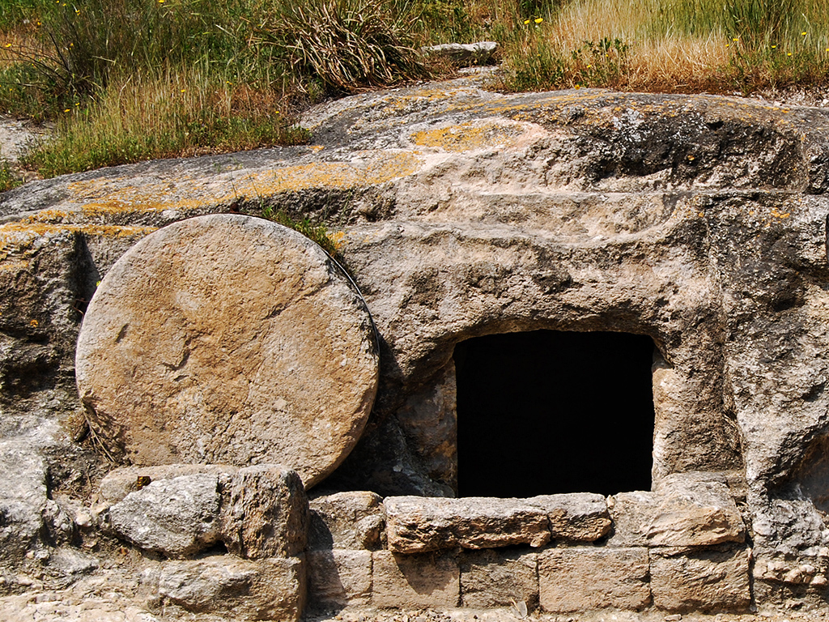
Tomb in Jezreel Valley
Photo by Ferrell Jenkins

Slide 5
Main facts
1
Jesus was resurrected
2
The New Testament came from eyewitnesses

Slide 6
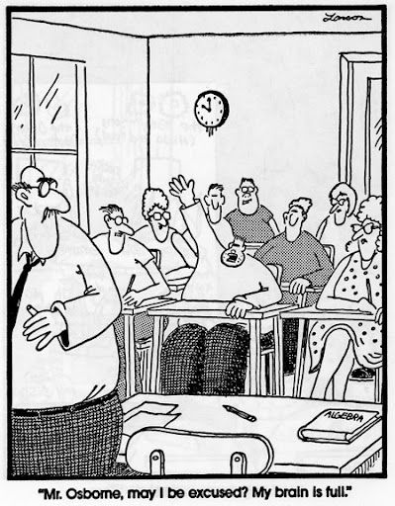

Slide 7
Why focus on a defense of the resurrection?
1
It’s Biblical
2
It’s simpler & easier (since the Gospel is your strength)
3
Become more knowledgeable about the Gospel accounts

Slide 8
Values & Needs
“I want Christianity to be true”
Facts “I believe Christianity is true”
Christianity can explain values
(why racism is wrong, why truth matters, etc.)
Undesigned coincidences
Eyewitness sources
Christianity can fill our deepest needs (hope, love, forgiveness, justice)
Christianity shouldn’t exist (if not for Jesus’ resurrection)
Ancient Jewish teaching practices
Prophecy (Isaiah 53)

Slide 9
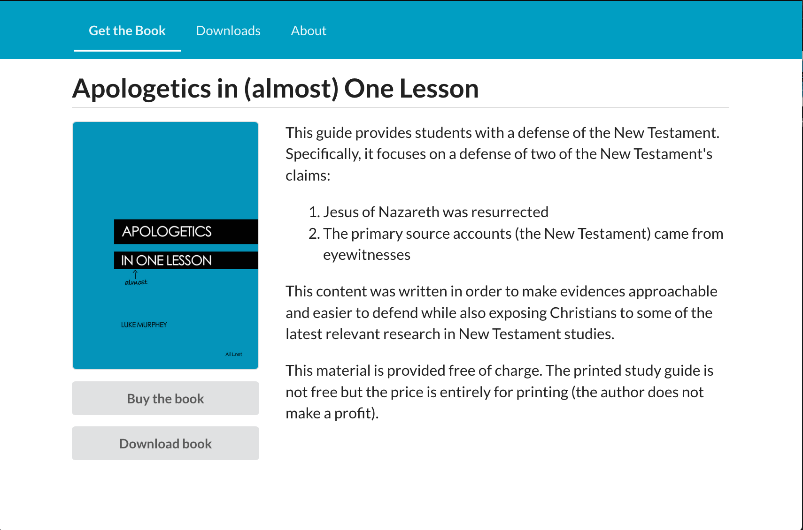
https://Ai1L.net

Slide 10
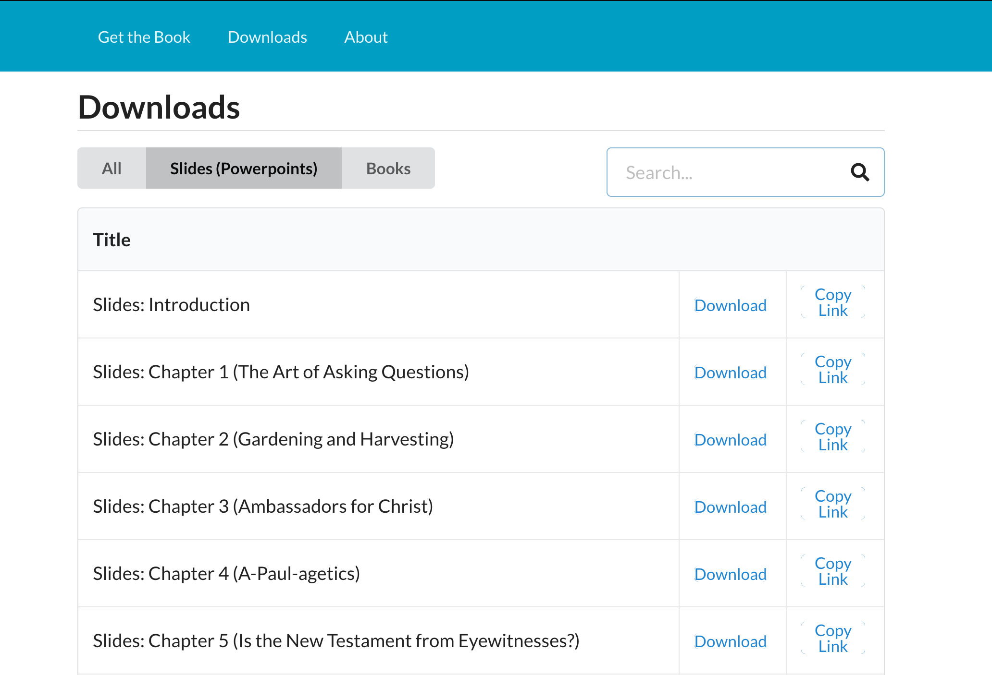

Slide 12
Four facts support Jesus’ resurrection
1
Jesus was crucified
2
Jesus’ disciples believed he resurrected
3
Early skeptics (Paul, James) became believers
4
The tomb was empty

Slide 13
Key Takeaways
1
The approach we use is important; probably more than the arguments we use
2
Belief in Jesus is based upon one fact in history: Jesus’ resurrection
3
The resurrection can be supported by four facts: 1. Jesus was crucified
2. Jesus’ disciples believed he resurrected
3. Early skeptics (Paul, James) became believers
4. The tomb was empty

Slide 14
Lesson | Goal
1. The Art of Asking Questions | Make discussing our convictions easier (set the bar low)
2. Gardening and Harvesting | Focus on making progress, don’t get excessively worried about results
3. Ambassadors for Christ | Our approach matters more than the arguments we use
4. A-Paul-agetics | Use cultural ideas to promote the Gospel

